Slide 1
CLAM FSM in SLAM
Grant ZHOU
June, 2008

Slide 2
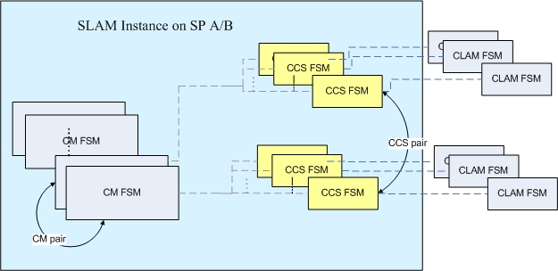
Overview
CM FSM – Board FSM in SLAM
CCS SM – CLAM FSM in SLAM
CLAM FSM – Located in CCS etc processes on CM

Slide 3
Data structures (1)
SLAM cotrol block (sl.h)
typedef struct slCb
{
U32 logLevel;
Region region;
Pool pool;
CmFsmCp brdFsmCp; /* BRD/board FSM control point */
SlBrdCb brdTb[MAX_SP_SLOT+1]; /* BRD/board FSM instances */
CmFsmCp iomBrdFsmCp; /* IOM BRD/board FSM control point */
SlIomBrdCb iomBrdCb[MAX_SP_SLOT+1]; /* IOM BRD/board FSM instances */
CmFsmCp clamFsmCp; /* CLAM FSM control point */
SlClamCb *clamTb[TELICA_MAX_CLAM_ID+1]; /* CLAM FSM instances */
SlCcsCb ccsTb[TELICA_MAX_CCS+1]; /* list of CCSs */
...
} SlCb;

Slide 4
Data structures (2)
typedef struct slClamCb /* SLAM CLAM Control Block */
{ U8 clamType;
U8 slot; /* back reference to CM slot */
U8 cpu; /* CPU that this CCS is running on */
U8 inst;
CmFsmEnt fsmEnt;
U16 partnerClamId;
U8 xuSta; /* relay status, TRUE=IS; FALSE=OOS */
U8 clmSta; /* TRUE=IS; FALSE=OOS */
U8 megacoSta; /* Bug: 34542 - TRUE=IS, FALSE=OOS */
U8 mgAssoc; /* TRUE=associated; FALSE=not-associated */
U8 mgAssocPend; /* TRUE=reserved, assoc in progress; FALSE=no assoc in progress */
U8 mgName[MG_NAME_LEN+1];
U16 mgPort;
U16 m3uaPort;
U16 sipPort;
U16 gdiPort;
U16 iuaPort;
U16 dnsPort[48];
U8 dnsPortPres;
U8 dnsNumPorts;
U16 dnsPortUsage;
U8 rewindStarted; /* used only on standby slam */
U16 m2uaPort;
U16 m2paPort[16];
U8 subFsm; /* used for DB access and other FSM access */
U8 subState1;
struct boot
{ U32 tableIdx; /* the table index that we are retrieving from DB */
CmTbCb bootTbls;
U8 plbkIteration; /* Bug 51313: support large table rewind */
void *blkPlbkCntRow;
U16 clamBootStage; /* 6-3: FID 2282 - LM staged rewind support */
U16 stageCounter;
U8 plbkCfmRcvd;
} boot;
PTR mglVarCtx; /* The MGL's MG Variant context (handle) */
} SlClamCb;

Slide 5
States
signaling/lm/slam/base/sl_clam_fsm.c
/* states */
CmFsmStateInfo slClamStates[] =
{
{"SLCLAM_ST_OOS", 0},
{"SLCLAM_ST_IDLE", 0},
{"SLCLAM_ST_ACT_BOOTING", 12000},
{"SLCLAM_ST_SBY_BOOTING", 18000}, /* Bug 51313 - increase timeout to 30min */
{"SLCLAM_ST_ACT_STANDALONE", 0},
{"SLCLAM_ST_SBY_READY", 0},
{"SLCLAM_ST_ACT_SYNCING", 8000},
{"SLCLAM_ST_SBY_SYNCING", 8000},
{"SLCLAM_ST_ACT_SYNCED", 0},
{"SLCLAM_ST_SBY_HOT", 0},
{"SLCLAM_ST_DLT_MGCASSOC_PENDING", 0},/* bug33470:handles clamfsm changes after dlt-mgc-mgassoc */
{"SLCLAM_ST_FN_DEFND", 0},
};

Slide 6
Events
signaling/lm/slam/base/sl_clam_fsm.c
/* Events */
CmFsmEventInfo slClamEvents[] =
{
{"SLCLAM_EV_BRD_OOS"},
{"SLCLAM_EV_BRD_IS_ACT"},
{"SLCLAM_EV_BRD_IS_SBY"},
{"SLCLAM_EV_XU_UP"},
{"SLCLAM_EV_XU_DOWN"},
{"SLCLAM_EV_CLAMFSM_OOS"},
{"SLCLAM_EV_CLAMFSM_SBY_READY"},
{"SLCLAM_EV_CLAMFSM_SET_SBY_STATE"},
{"SLCLAM_EV_CLAM_IS"},
{"SLCLAM_EV_CLAM_OOS"},
{"SLCLAM_EV_CLAM_STCHNG_CFM"},
{"SLCLAM_EV_CLAM_PLYBCK_CFM"},
{"SLCLAM_EV_DB_CFM"},
{"SLCLAM_EV_TL1FSM_MGCASSOC"},
{"SLCLAM_EV_TIMEOUT"},
{"SLCLAM_EV_DLT_MGCASSOC_PENDING"}, /* bug33470:handles clamfsm ST changes after dlt-mgc-mgassoc */
};

Slide 7
FSM initialization
Initialization of the SLAM CLAM FSM:
    slActvInit
    →slClamInit
Highlights:
  Initialize the control black (slCb.clamFsmCb)
  Allocates clam for entries in slCPUClamLst with clamType set (slCPUClamLst)
  Index = TELICA_GET_CLAM_ID(slot, cpu, inst)
  Initialize the CCS control block, mgName hash list and versioned SLAM boot matrix

Slide 8
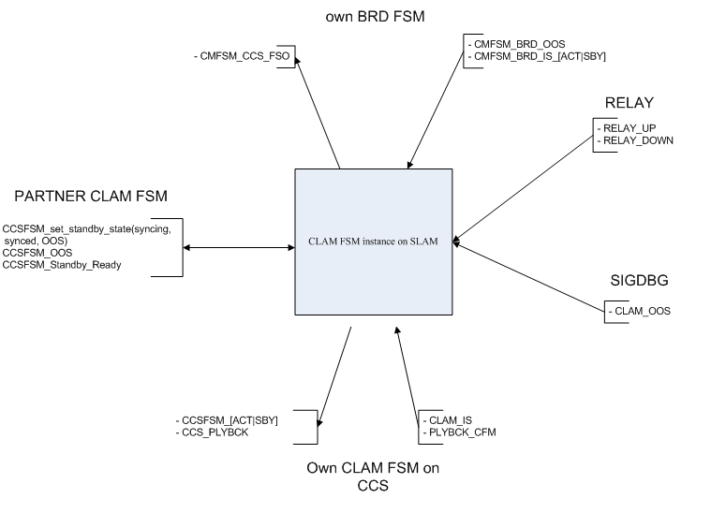
SLAM CLAM FSM Matrix
signaling/lm/slam/base/sl_clam_fsm.c
CmFsmRow slClamFsmMt[SLCLAM_ST_MAX][SLCLAM_EV_MAX]
Notes:
sigdbg:::::slamDbg cmd options
slamDbg in sl_sigdbg.c
sigdbg:::::abortauditfail slot/cpu/inst

Slide 9
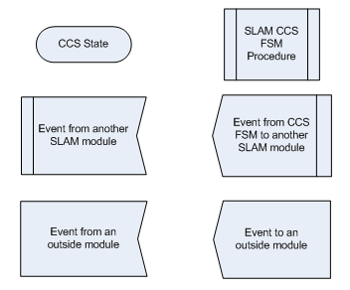
Description

Slide 10
SLCLAM_ST_OOS(1)
SLCLAM_ST_OOS
  The FSM is initialized to this state at first
  CCS is OOS, or when the SLAM cannot communicate with the CCS (relay not up, or CLAM on the CCS has not sent the initial IS event)

Slide 11
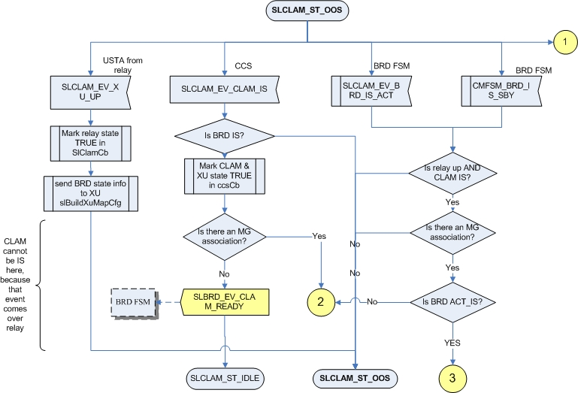
SLCLAM_ST_OOS(2)
Notes:
clProcessStateChange
CL_EV_IS_ACT
oldState == CCS_INIT_STATE && newState == CPU_BOOTING_ACT
oldState == CPU_ACTIVE_SYNCED && newState == CPU_ACTIVE_STANDALONE
oldState == CPU_STANDBY_HOT && newState == CPU_ACTIVE_STANDALONE
oldState == CPU_ACTIVE_SYNCING && newState == CPU_ACTIVE_STANDALONE
CL_EV_IS_SBY
oldState == CCS_INIT_STATE && newState == CPU_BOOTING_STBY

Slide 12
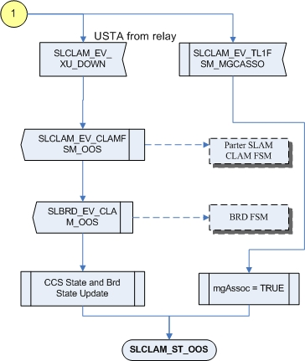
SLCLAM_ST_OOS(3)

Slide 13
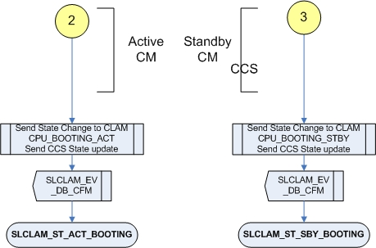
Common Handler on STBY and ACTIVE
Common handler on ACTIVE and STBY before change to BOOTING state

Slide 14
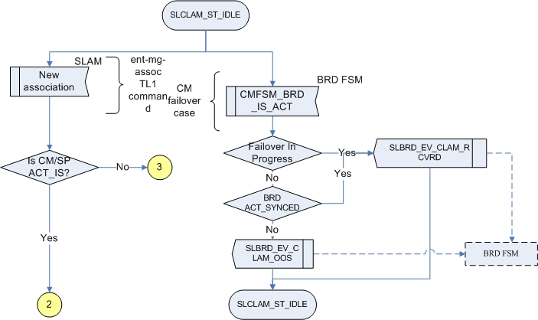
SLCLAM_ST_IDLE

Slide 15
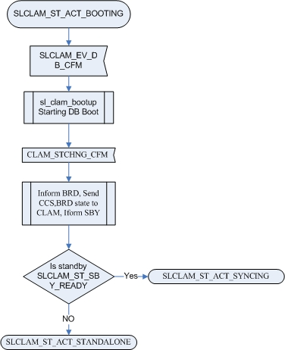
SLCLAM_ST_ACT_BOOTING
SLCLAM_EV_DB_CFM
Get the corresponding boot tables and starting DB boot, when boot finished send CLAM_STCHNG_CFM event.
How the FSM change the state from ACT_STANDALONE to ACT_SYNCING?

Slide 16
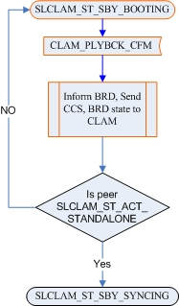
SLCLAM_ST_SBY_BOOTING
clam_sbyBoot_clam_plybck_cfm

Slide 17
SLCLAM_ST_ACT_SYNCING
After SLCLAM_EV_CLAM_STCHNG_CFM, it will send SLCLAM_EV_CLAMFSM_SET_SBY_STATE to STBY,

Slide 18
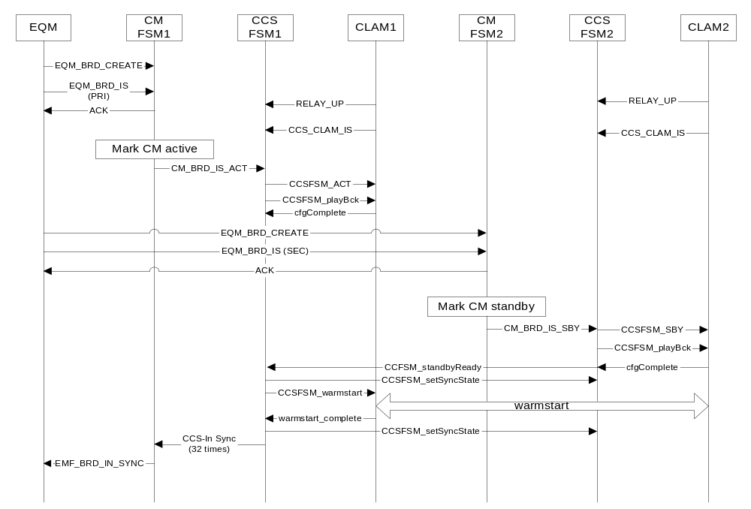
Sample startup

